Slide 1
Optimizing Hospitality: Data-Driven Insights into India's Hotel Economy
Presented by :
R. ANIL

Slide 2
PROJECT OBJECTIVE
The hospitality industry in India is dynamic and competitive, comprising a diverse range of hotels catering to varying customer preferences. Amidst this landscape, there exists a need to harness data driven insights to optimize the operations, marketing strategies, and overall efficiency of hotels across the country. The lack of comprehensive insights derived from available data poses a challenge in effectively understanding customer preferences, pricing strategies, and service offerings that could potentially enhance the Indian hotel economy.

Slide 3
MAIN AGENDA
Web Scrapping to collect the data
Data Cleaning and Manipulation
Visualization and Analysis on various factors like Price, Location, Review’s….etc…. to analyze above problem statements.
An in-depth exploration of web scraping and data visualization using python on “Make my trip” website and retrieve hotels data from tier 1 cities from country. Learn the power of extracting and visualizing data for insightful analysis.

Slide 4
INTRODUCTION
Overview of project:-
Discover the main objectives and scope of Project hospitality Analysis for web scraping and Data cleaning , Data Modelling , Data preprocessing In Python and data visualization in Power bi.
Importance of Analyzing Hotel Data:-
Analyzing Hotel Data is crucial for various reasons, and it can provide valuable insights for both consumers and businesses.
Importance of web scraping and data preprocessing and data visualization:-
Explore why web scraping and data preprocessing and data visualization are critical for obtaining and understanding valuable data.

Slide 5
TOOLS USED
Software Requirement:-
Python(Jupyter notebook)
Tableau
Excel
Main Software Libraries:-
Pandas
Numpy
Beautiful Soups
Requests
CSV

Slide 6
CODE
import requests
from bs4 import BeautifulSoup
import pandas as pd
import csv
url = "https://www.booking.com/searchresults.en-gb.html?ss=Bangalore&ssne=Bangalore&ssne_untouched=Bangalore&label=gen173nr-1BCAEoggI46AdIM1gEaGyIAQGYAQm4ARfIAQzYAQHoAQGIAgGoAgO4Atn12bsGwAIB0gIkZTIzOGJiOTYtZTIwZi00MzgxLTk4NjAtNWY3N2M2ZjVmMTE02AIF4AIB&sid=514f12132df0b939a92fd18410e8d0fa&aid=304142&lang=en-gb&sb=1&src_elem=sb&src=searchresults&dest_id=-2090174&dest_type=city&checkin=2025-01-24&checkout=2025-01-25&group_adults=1&no_rooms=1&group_children=0"
headers = {
"User-Agent": "Mozilla/5.0 (Windows NT 10.0; Win64; x64) AppleWebKit/537.36 (KHTML, like Gecko) Chrome/96.0.4664.110 Safari/537.36",
"Referer":"https://www.booking.com/searchresults.en-gb.html?ss=Bangalore&ssne=Bangalore&ssne_untouched=Bangalore&label=gen173nr-1BCAEoggI46AdIM1gEaGyIAQGYAQm4ARfIAQzYAQHoAQGIAgGoAgO4Atn12bsGwAIB0gIkZTIzOGJiOTYtZTIwZi00MzgxLTk4NjAtNWY3N2M2ZjVmMTE02AIF4AIB&sid=514f12132df0b939a92fd18410e8d0fa&aid=304142&lang=en-gb&sb=1&src_elem=sb&src=searchresults&dest_id=-2090174&dest_type=city&checkin=2025-01-24&checkout=2025-01-25&group_adults=1&no_rooms=1&group_children=0"}

Slide 7
try:
response = requests.get(url, headers=headers)
if response.status_code == 200:
print("Access Granted. Status Code:", response.status_code)
else:
print("unexpected Status Code:", response.status_code)
except requests.exceptions.requestException as e:
print("Error:",e)
soup = BeautifulSoup(response.content,'html.parser')
soup
divs = soup.find_all("div",class_="c624d7469d a0e60936ad a3214e5942 b0db0e8ada")
hotal_names=[div.find("div",class_="f6431b446c a15b38c233").string for div in divs]
loc = [div.find("span",class_="aee5343fdb def9bc142a").string for div in divs]
price = [div.find("span",class_="f6431b446c fbfd7c1165 e84eb96b1f").string[2:] for div in divs]
sharing = [div.find("div",class_="abf093bdfe f45d8e4c32").text for div in divs]

Slide 8
facilities = [
div.find("h4", class_="abf093bdfe e8f7c070a7").text
if div.find("h4", class_="abf093bdfe e8f7c070a7") is not None
else "N/A"
for div in divs
]
review = [
div.find("div", class_="a3b8729ab1 d86cee9b25").text[10:]
if div.find("div", class_="a3b8729ab1 d86cee9b25") is not None
else "N/A"
for div in divs
rrr = [
''.join(filter(str.isdigit, div.find("div", class_="abf093bdfe f45d8e4c32 d935416c47").text))
if div.find("div", class_="abf093bdfe f45d8e4c32 d935416c47") else ""
for div in divs
]
int_values = [int(value) for value in rrr if value != ""]

Slide 9
star = []
for card in divs:
rating_stars = card.select_one("div[data-testid='rating-stars']")
star_count = len(rating_stars.find_all("span")) if rating_stars else "N/A"
star.append(star_count)
x = pd.DataFrame()
x["Hotel"]=hotal_names
x["Location"]=loc
x["Prices"]=price
x["Rating"]=review
x["reviwes_count"]=rrr
x["star"]=star
x["Share"]=sharing
x["Facilitys"]=facilities
x.to_csv("bangalore.csv")
df = pd.read_csv("bangalore.csv")
df['city'] = df['Location'].str.split(',').str[-1].str.strip()
df

Slide 10
DATA CLEANING :
import pandas as pd
df=pd.read_csv(r"C:\Users\ravur\Videos\EXCELLENC\project\tires of cities\bangalore.csv")
df1=pd.read_csv(r"C:\Users\ravur\Videos\EXCELLENC\project\tires of cities\Chennai.csv")
df2=pd.read_csv(r"C:\Users\ravur\Videos\EXCELLENC\project\tires of cities\delhi.csv")
df3=pd.read_csv(r"C:\Users\ravur\Videos\EXCELLENC\project\tires of cities\mumbai.csv")
df4=pd.read_csv(r"C:\Users\ravur\Videos\EXCELLENC\project\tires of cities\pune.csv")
merged_data=pd.concat([df,df1,df2,df3,df4],ignore_index=True)
merged_data.head()
merged_data.isna().sum()
Q=merged_data.fillna(0)
Q['Prices'] = Q['Prices'].str.replace(',', '').astype(float)
Q.to_csv("all.csv")
df=pd.read_excel("data.xlsx")
A=df.drop(["Unnamed: 0.1","Unnamed: 0"],axis=1)

Slide 11
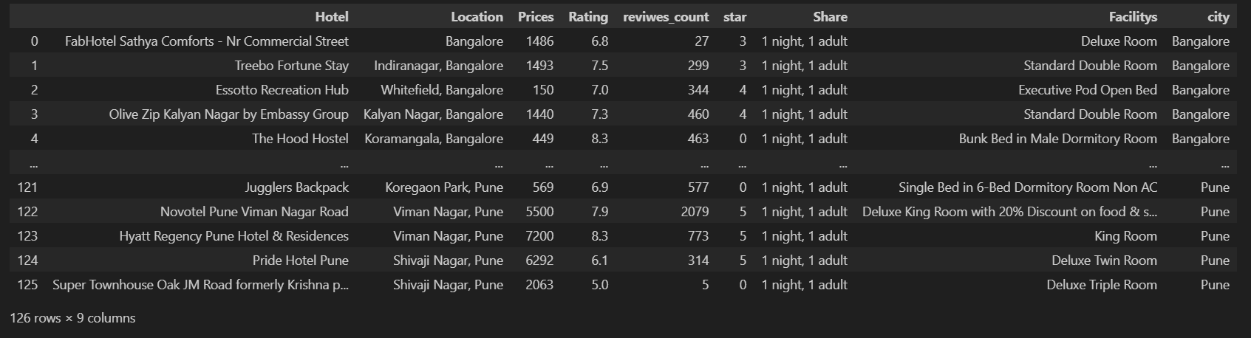
OUTPUT

Slide 12
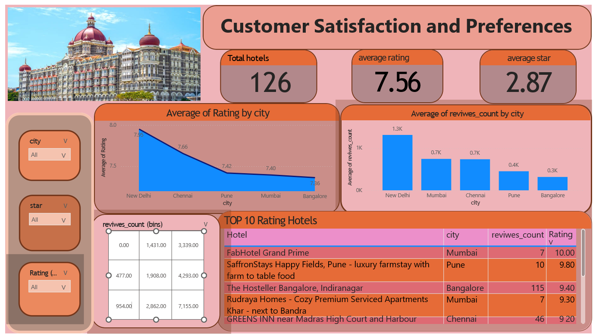
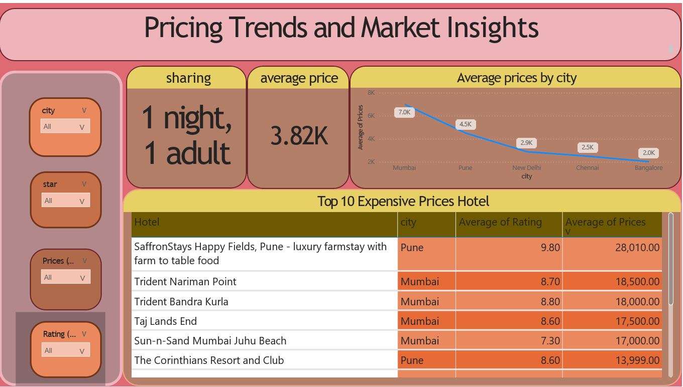
DASHBOARDS

Slide 13
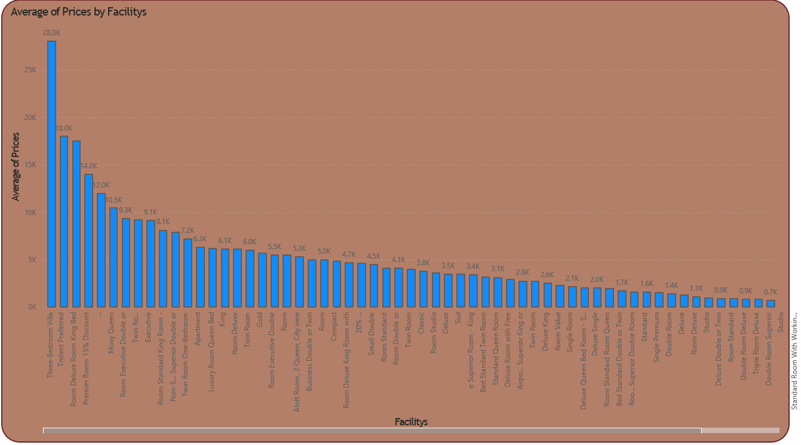

Slide 14
KEY INSIGHTS
Customer Preferences
Key drivers: service quality, cleanliness, location, free cancellation, and complimentary breakfast.
Hotels with ratings >8 dominate positive reviews.
Pricing Trends
Price range: ₹150 (budget) to ₹46,000 (luxury).
Bangalore leads luxury pricing (~₹10,191); mid-range dominates the market.
Geographic Trends
High demand in Mumbai, Delhi, and Bangalore; coastal regions show high satisfaction.
Untapped potential in tier-2 cities for expansion.
Market Segmentation
Budget Hotels: Low ratings (~6.3) but high occupancy.
Luxury Hotels: High ratings (~8.3), premium pricing, affluent customer base.

Slide 15
CONCLUSION
For Hoteliers:
Focus on cleanliness, amenities, and dynamic pricing in metro areas.
For Policy Makers:
Standardize service quality and invest in underserved regions.
For Marketing Teams:
Target campaigns based on regional preferences and demand patterns.
Summary: Aligning offerings with customer needs and optimizing pricing strategies will boost satisfaction and market growth.

Slide 16
THANK YOU

